Slide 1

Data Science For Social Good: Colombian Land-Use
Vivek Kantamani

Slide 2
Data Science Process
Problem
*What is the problem?
*What are the goals – efficiency, profitability, scale, etc.
Analytical Approach
*Descriptive – Identify characteristics of the problem. (Clustering, Recommender Systems)
*Diagnostic (Statistical Analysis) – What happened? / Why is this happening?
*Predictive (Forecasting) – What if the trends continue? (Classification / Linear Regression)
*Prescriptive – How do we solve the problem?
OSEMN Framework
*Obtain Data – What data is needed? What are the sources of data? Representative?
Scrub (Clean) Data
*Explore - Patterns and Trends
*Model – Descriptive vs Predictive
*Interpret – Acquaint yourselves with the model.

Slide 3


Collaboration

Slide 4
Let’s dive in.

Slide 5
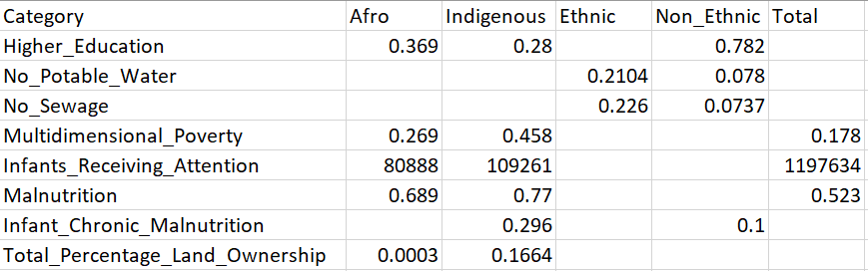
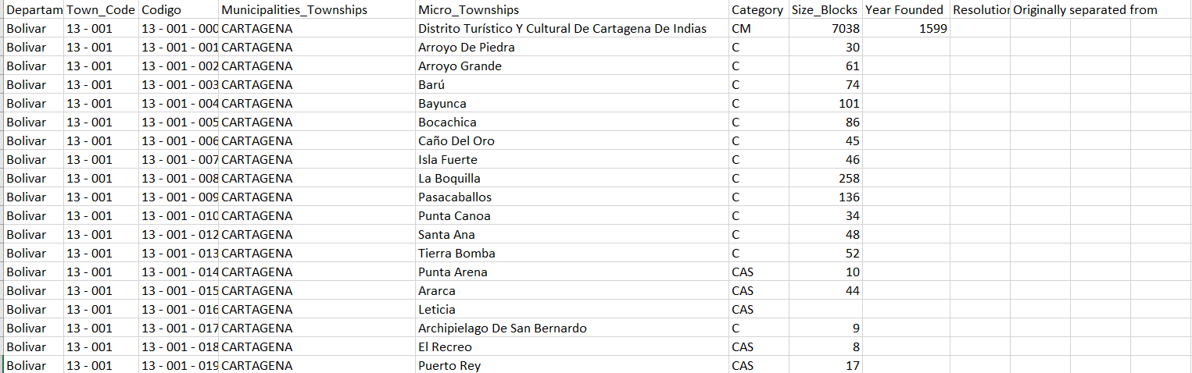

Slide 6
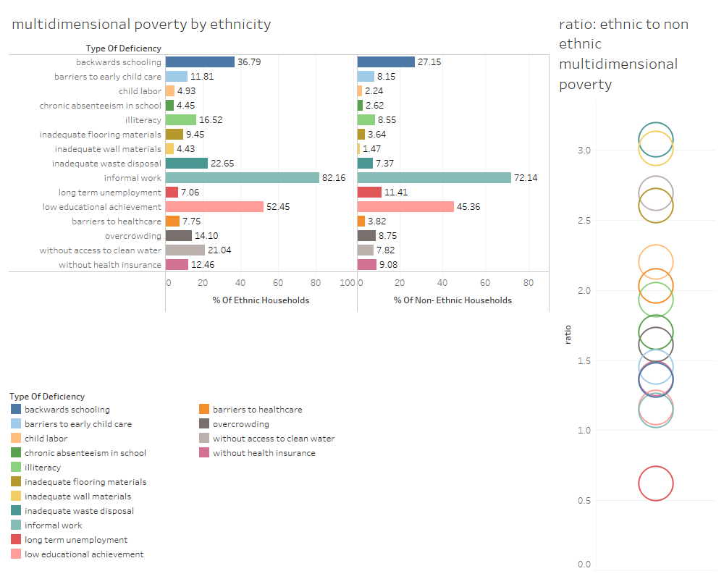

Slide 7
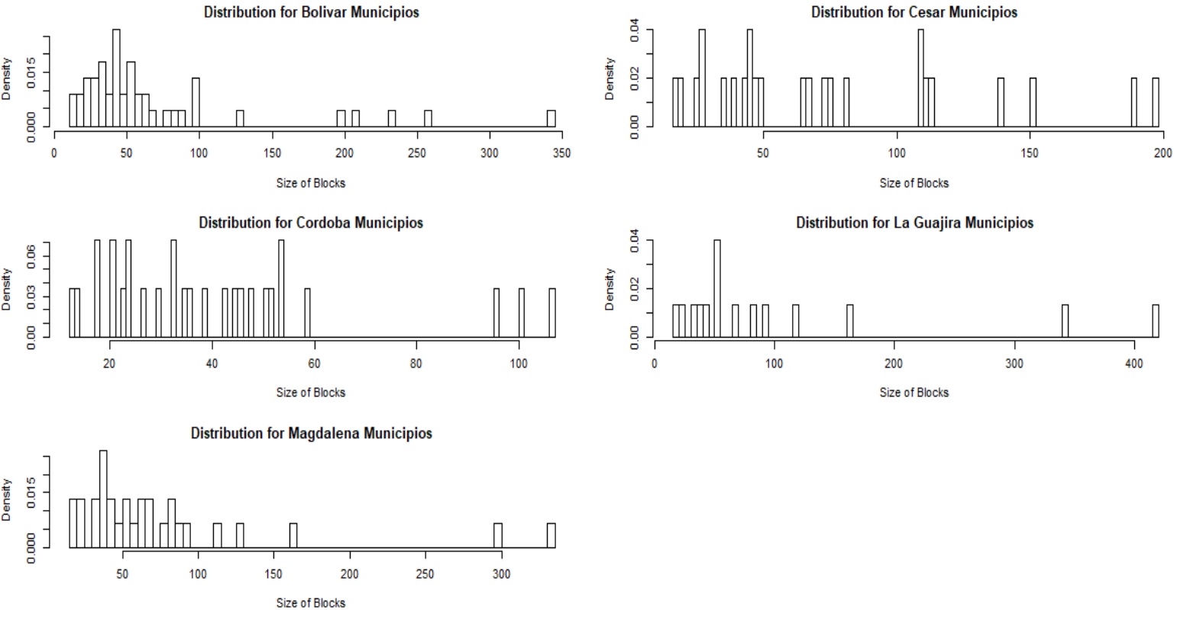

Slide 8
What is the PROBLEM we are trying to solve? What are the GOALS? How did we OBTAIN the data?

Slide 9

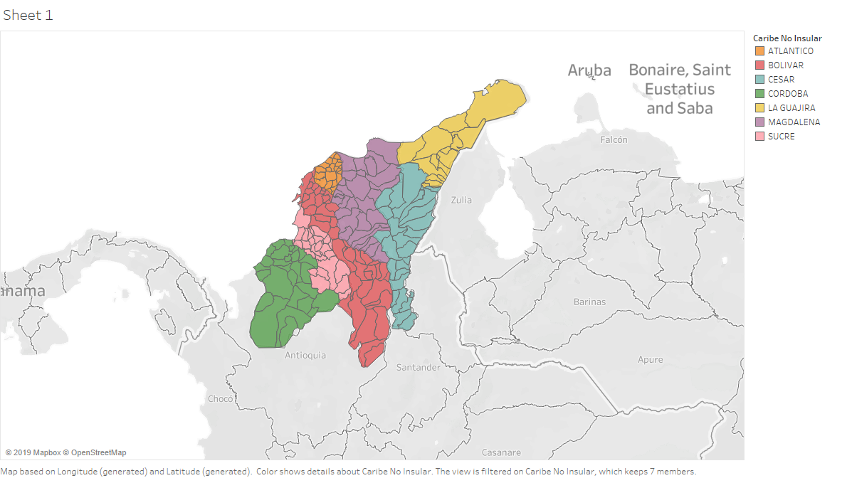




Slide 10
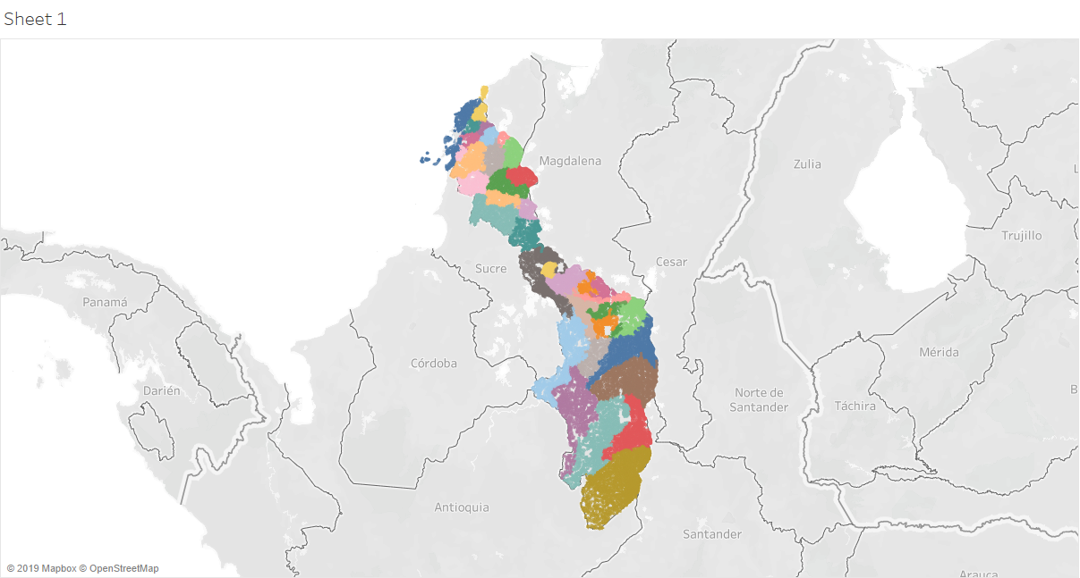

Slide 11
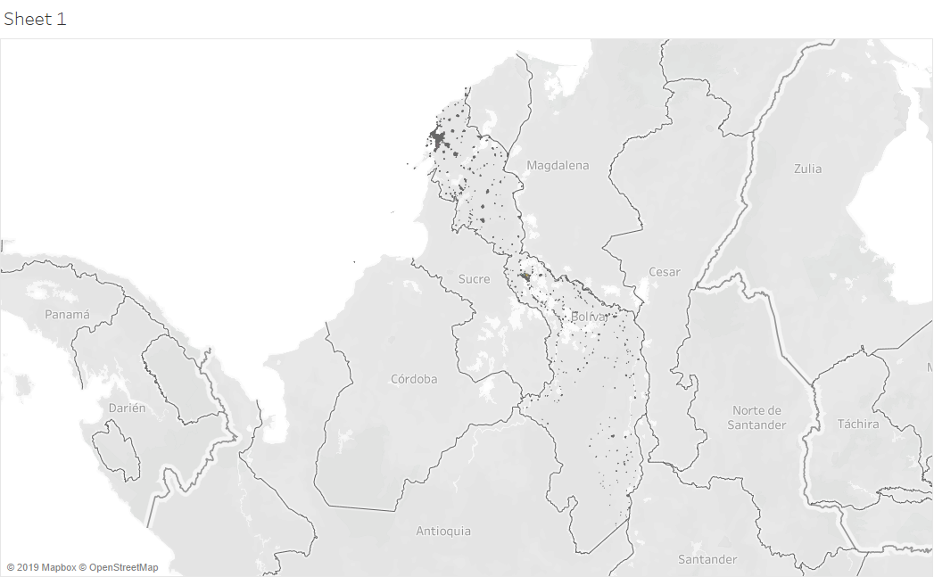

Slide 12
How do we express the PROBLEM in terms of data science?

Slide 13
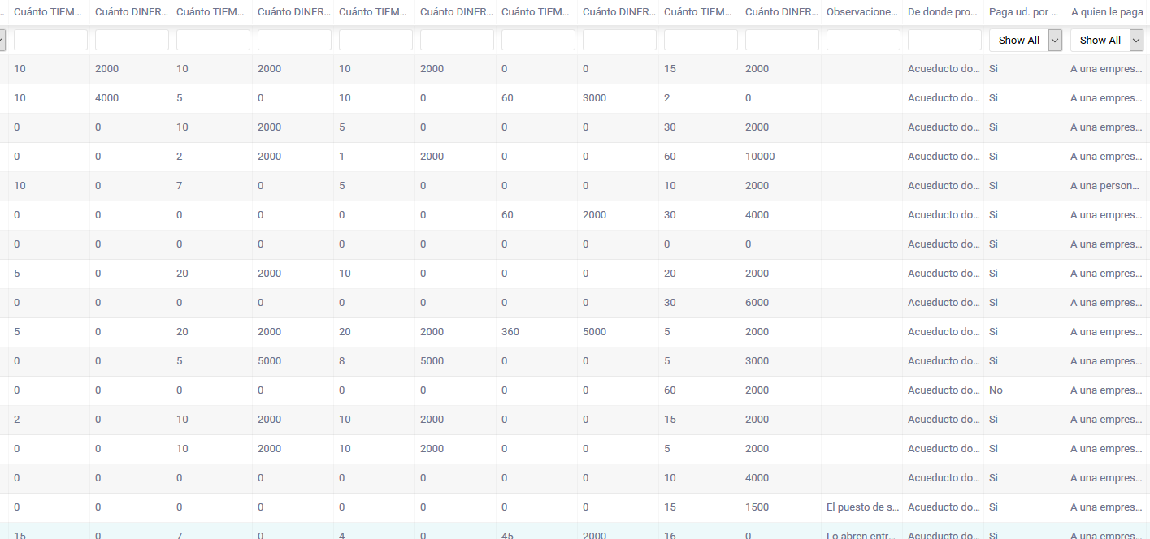

Slide 14
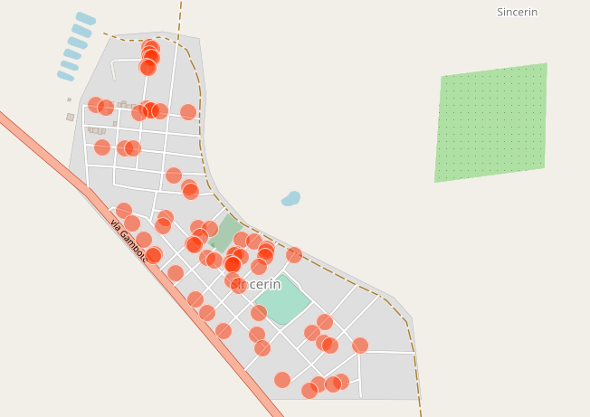

Slide 15
Let’s improve how we OBTAIN data. Let’s EXPLORE the data.

Slide 16
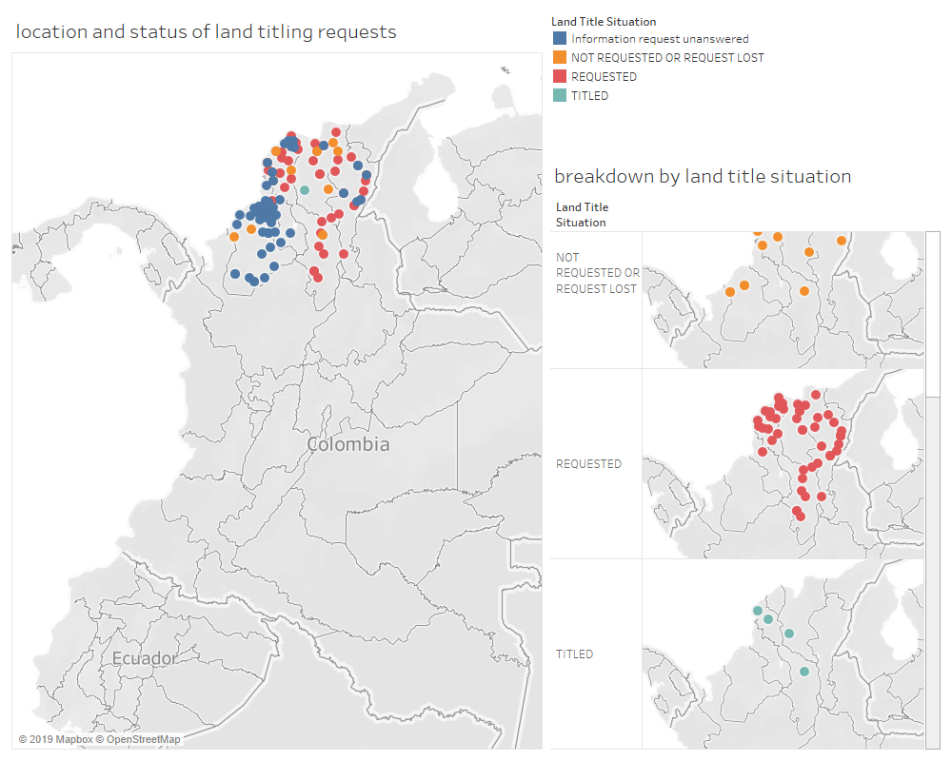

Slide 17
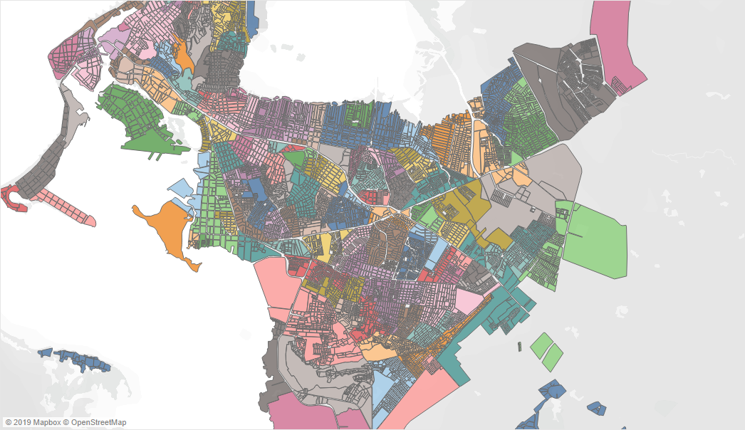

Slide 18
What about MODELING and INTERPRETING? What about DESCRIPTION and PREDICTION?

Slide 19
Questions?

